Slide 1
Developing Integration Solutions using Microsoft BizTalk Server 2016
Deploying and Managing Applications

Slide 2

Course Outline
Module 1: Introduction to BizTalk Server
Module 2: Schemas
Module 3: Maps
Module 4: Testing and Deploying BizTalk projects
Module 5: Pipelines
Module 6: Routing
Module 7: Adapters
Module 8: Web Services and WCF
Module 9: Introduction to Orchestrations
Module 10: Applied Orchestration Techniques
Module 11: Business Activity Monitoring
Module 12: Business Rules
Module 13: Deploying and Managing Applications
Lesson 1: Introduction to Applications and Projects
Lesson 2: Working with the BizTalk Administration tools

Slide 3
Lesson 1: Introduction
The Application container
Deploying a project
Demonstration: Deploying from Visual Studio
Grouping artifacts into projects and solutions
Versioning artifacts

Slide 4
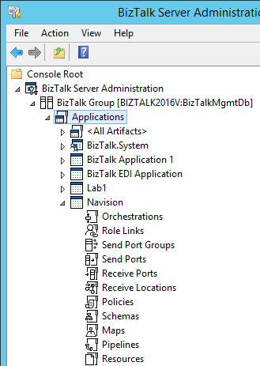
What is a BizTalk Application?
A BizTalk Application is a logical container for BizTalk Artifacts and Messaging Components (and other resources).
BizTalk Artifacts
Schemas
Maps
Pipelines
Orchestrations
Messaging Components
Receive ports
Receive locations
Send ports
Send port groups
Other
Policies
Role Links
Resources (BAM definitions, binding files, assemblies, scripts etc.)

Slide 5


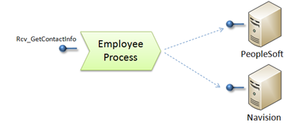


What is a BizTalk Application?
A BizTalk Application allows us to create logical groups for management, deployment and troubleshooting purposes.
What do we equate it with?
System
Process
Hybrids
Unit of deployment

Slide 6

Special Applications
BizTalk.System
Default Application
Contains common artifacts such as default schemas and pipelines.
Automatically referenced by all other applications.
Read-Only.
After install the default application is “BizTalk Application 1”.
Any application can become the default.
BizTalk Application 1 can be modified just as any other application and can even be removed.
Hint!
If no application is set on Deploy – it will be deployed to the default application.

Slide 7

Demo
Special Applications
Notes:
(Slide 9)

Slide 8
Lesson 2: Working with the BizTalk Administration Tools
Administration tools
Exporting and Importing an Application
Using command line tools
Using scripting and APIs
Demonstration: Export and Import

Slide 9
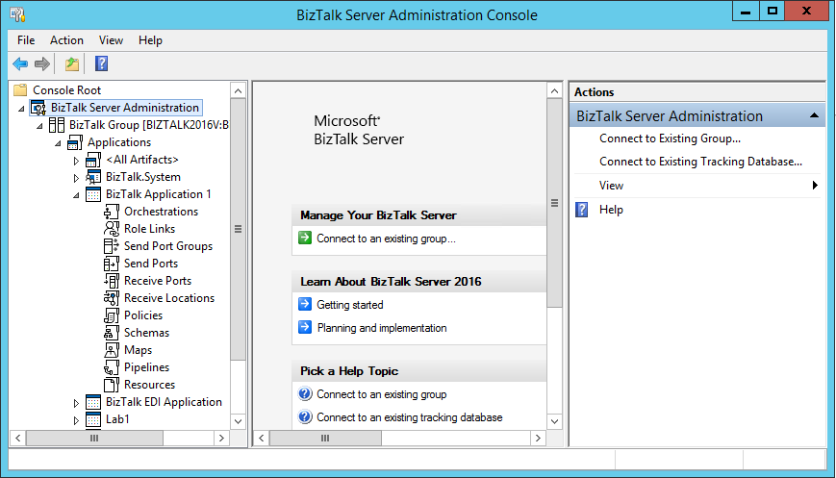
Administration Console
Configuration and Management
Applications
Ports, Adapters, Pipelines
Orchestrations
Start, Stop
Import, Export
Troubleshoot
MMC Console

Slide 10
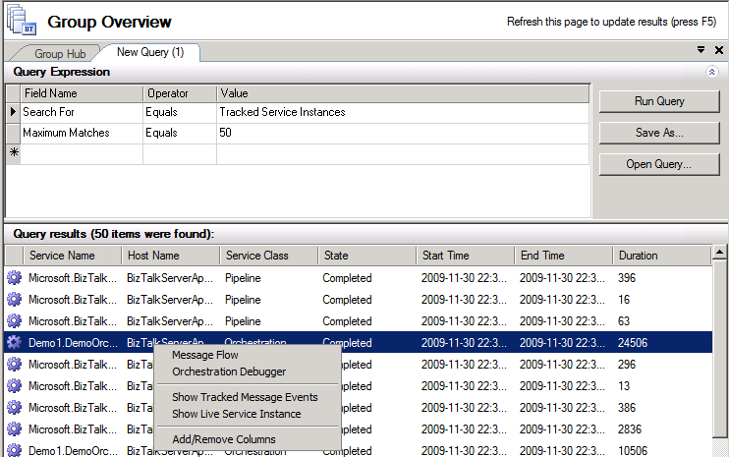
Health and Activity Tracking in BizTalk Server 2016
Tracked Service Instances
Tracked Message Events

Slide 11
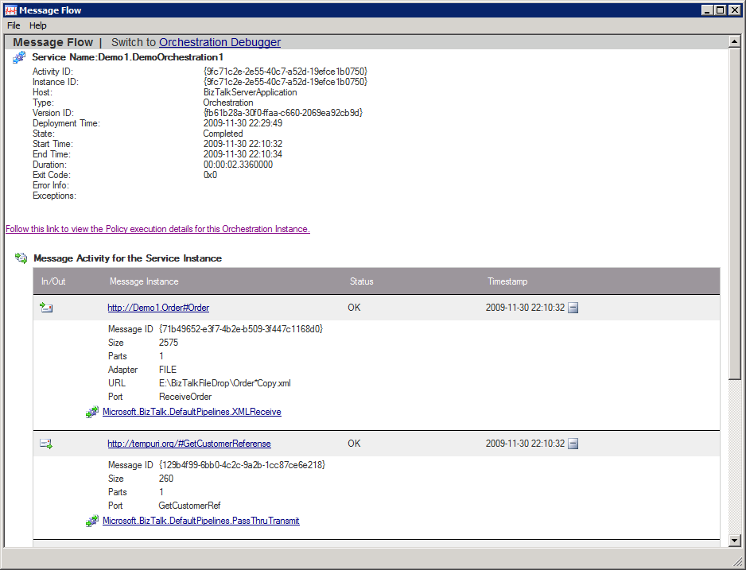
Message Flow
Looking at Message Flow

Slide 12
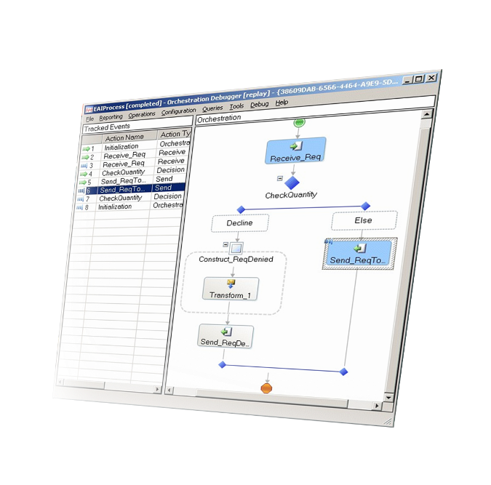
HAT - Orchestration Debugger
Debugging
Monitor orchestration instances and messages
Set breakpoints
Suspend, terminate, or resume processes
View variables and data
Orchestration Debugger

Slide 13
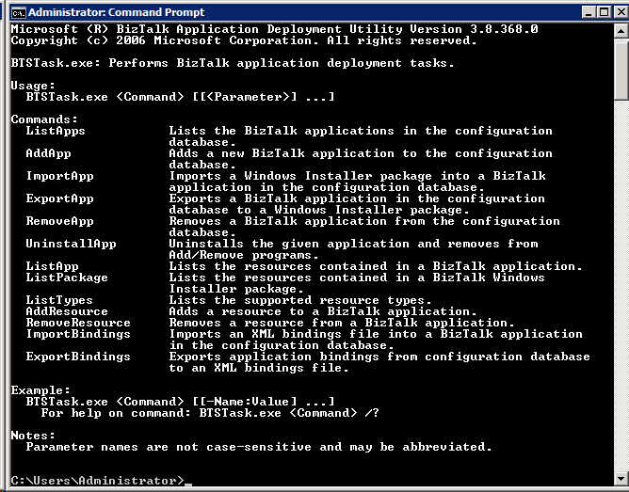
Using command line tools
BTSTask.exe
ListApps
AddApp
ImportApp
ExportApp
RemoveApp
UnistallApp
ListApp
ListPackage
ListTypes
AddResource
RemoveResource
ImportBindings
ExportBindings

Slide 14

Using scripting and APIs
BizTalk Explorer Object Model
Scripting
Microsoft.BizTalk.ExplorerOM.dll
32-bit only
Either BTSTask or WMI.
WMI allows you to manage the core objects associated with BizTalk Server.
Hint!
Hint!
See Admin\WMI (BizTalk Server Samples Folder) and WMI Samples in BizTalk Help.
See Admin\ExplorerOM (BizTalk Server Samples Folder) and ExplorerOM Samples in BizTalk Help.

Slide 15
Binding files

Slide 16
Demo
Export and Import
Export a MSI package through the Administration Console
Exporting a binding file
Removing an application
Importing an application and binding file through the command line

Slide 17



Deploying assemblies to BizTalk Server
Non-BizTalk assemblies
BizTalk Server
Install
GAC
BizTalk Assemblies
Install
Import
Configuration Database

Slide 18
Multi Server scenarios
Development
Production
Install
Install
Export Application
Import
.msi file

Slide 19
Summary
A BizTalk applications is a container that simplifies administration and development.
You group artifacts, ports, and resources into an application in an arbitrary fashion. An application can for example be the equivalent of a system, a process or a unit of deployment.
Binding file contain can be used to transport the configuration of an application (or part of) across environments.
MSI files can be used to transport all the resources of an applcation (or selected resources) across environments.

Slide 20
Q & A
Deploying and Managing Applications

Slide 21


Hands-On-Labs
Deployment and Management
Setting properties and deploying projects
Use the Administration Console to create ports
Use the Administration Console to Import Binding information
Bind Orchestration ports to physical ports
Export a BizTalk application to an MSI package
Import a BizTalk application from an MSI package
Use the Group Hub to manage suspended messages

Slide 22

Quiz
What is a binding file?
What are some of the things stored in a binding file?
What is a MSI package?
What can it contain?

